Slide 1
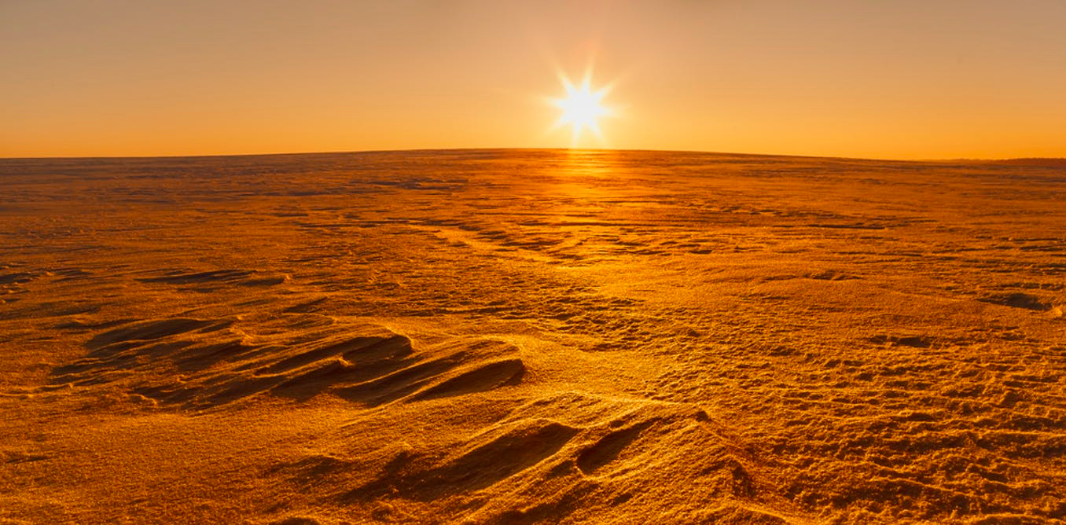

MARS AT LOW OBLIQUITY
ETIENNE DUPONT
18/06/2018

Slide 2
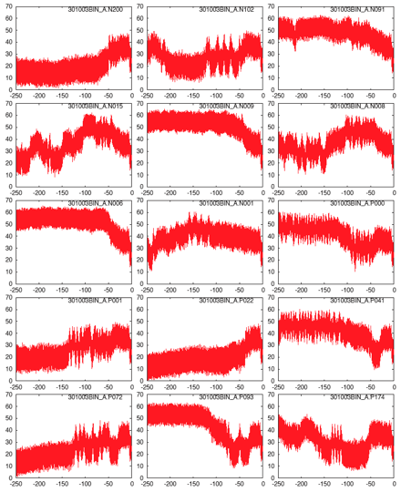
Motivations
Possible variations of obliquity for the past 250 Myrs
Laskar et al., 2004

Slide 3
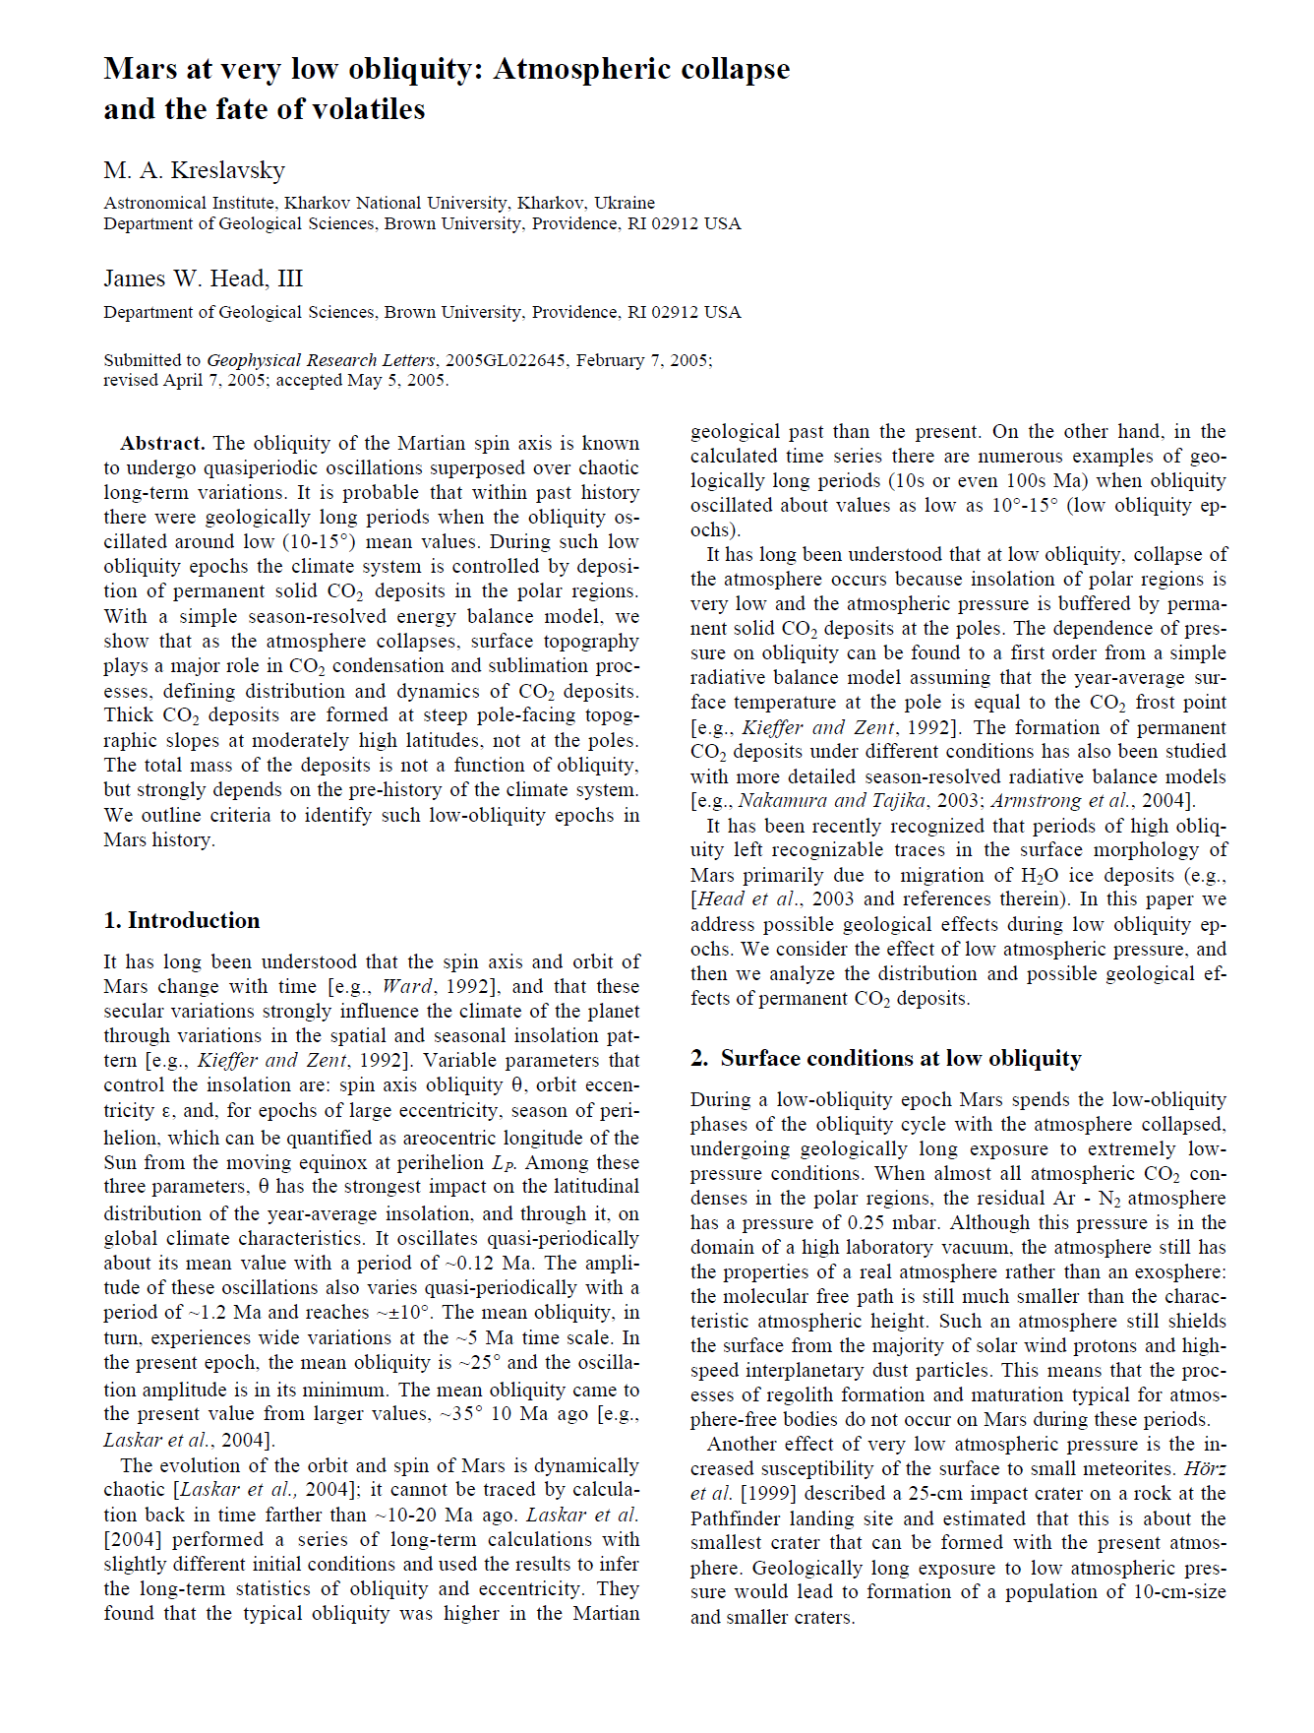
Motivations
At low obliquity, very thin Ar-N₂ atmosphere. Almost all atmospheric CO₂ has condensed
Notes:
Exiting phenomena : atmospheric collapse
Gaciers formation

Slide 4
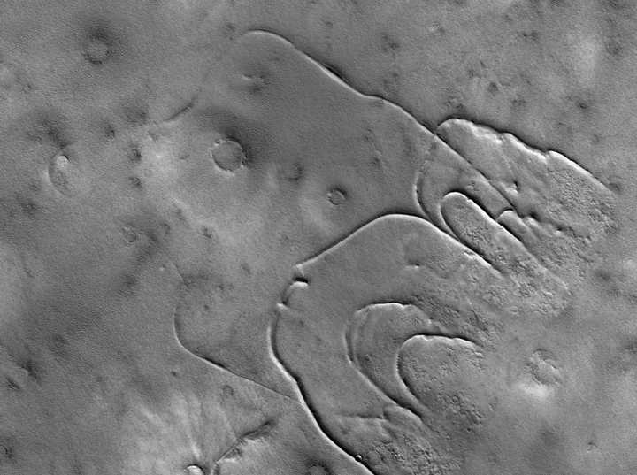
Motivations
CO₂ glaciers formation on poleward facing slopes at high latitudes?
Kreslavsky and Head, 2011
Notes:
We wanted to find out how and where CO2 would condense in a low obliquity scenario on Mars

Slide 5
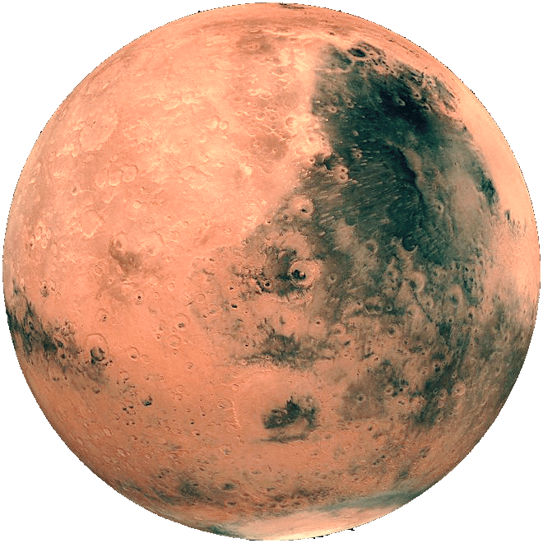
Our experiment
15°
7.5°
0°
25°
25°
25°
e = 0,093
e = 0,093
e = 0,093
e = 0
e = 0
e = 0
t = 0 yr
t = 5000 yr

Slide 6
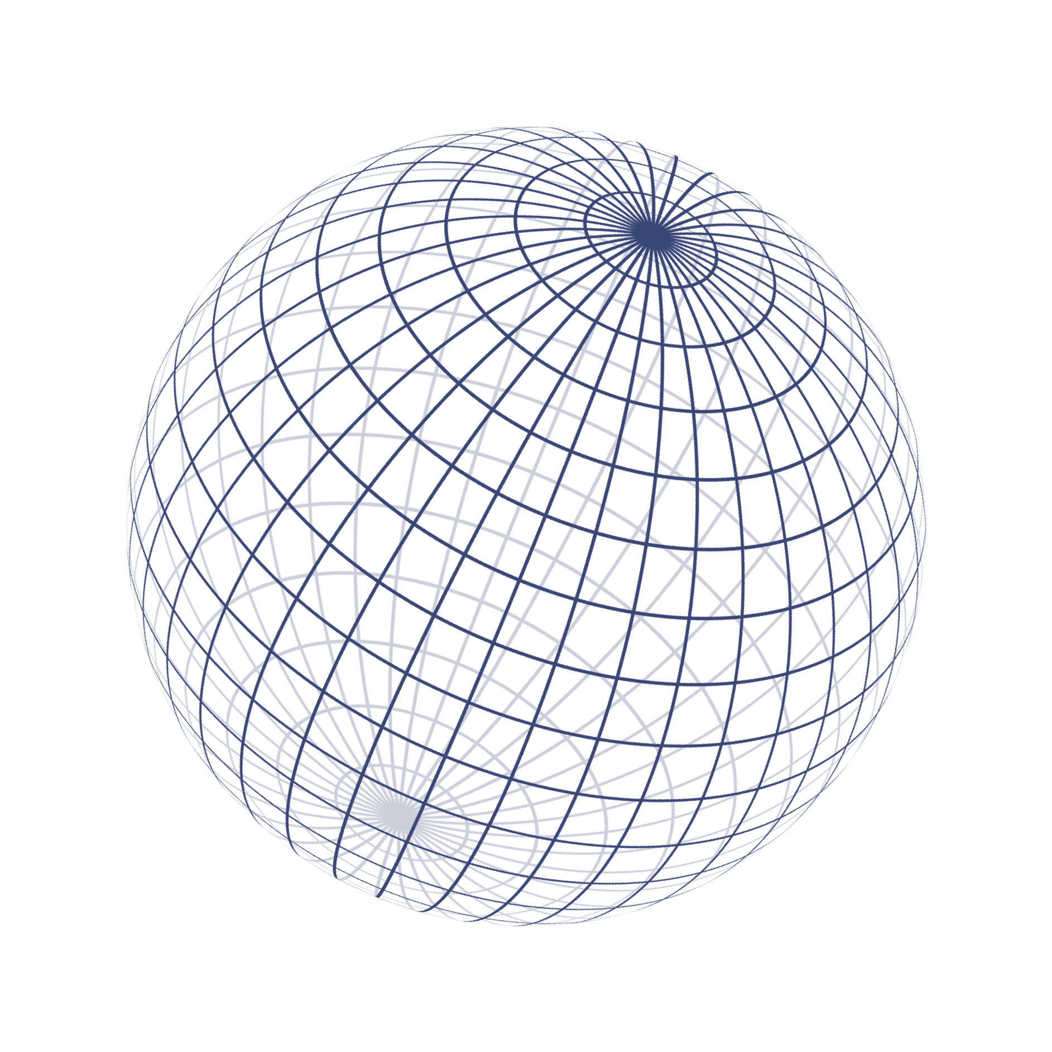
Smooth Mars experiment
With a simplified global climate model

Slide 7

Smooth Mars experiment
LMD simplified global climate model
Physical processes taken into account
Solar
flux
Thermal
IR
Turbulence and convection
Co2 ice condensation-sublimation
Ar-N2 enrichment & depletion
dust
dust
dust
CO2
Heat conduction
18 layers model
Sensible
Heat flux
Latent
Heat flux

Slide 8
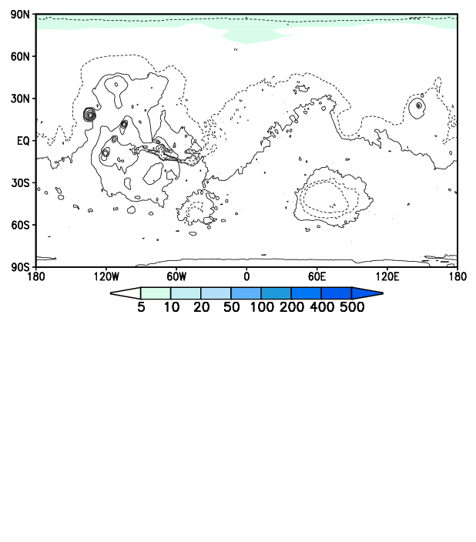
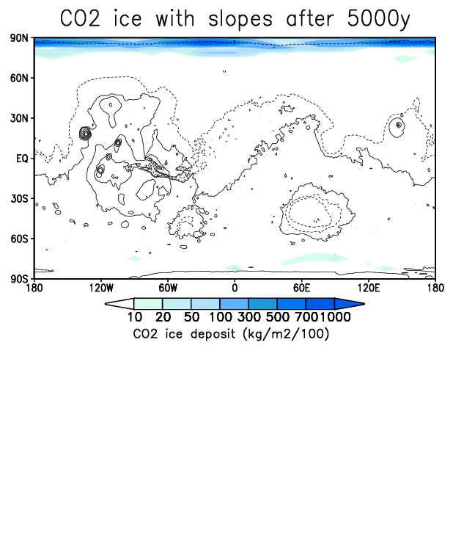
Smooth Mars experiment
7.5°
e = 0
t = 0 yrs

Slide 9
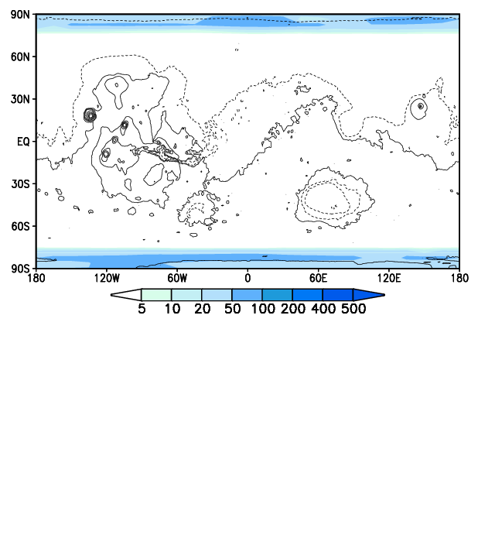
Smooth Mars experiment
7.5°
e = 0
t = 15 yrs

Slide 10
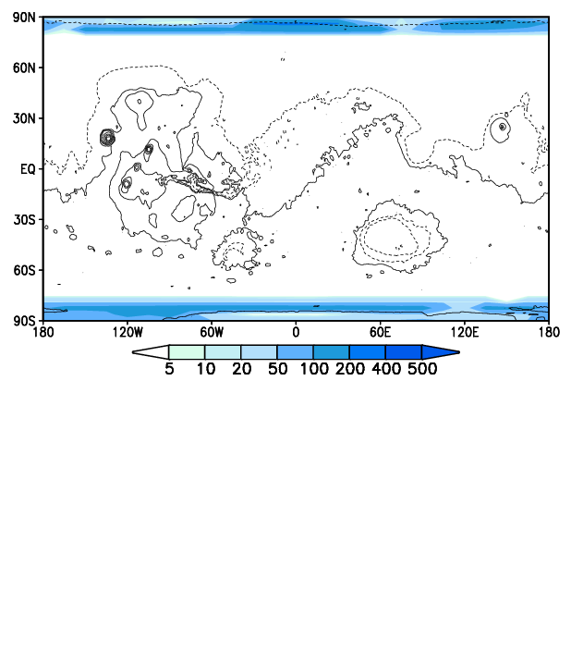
Smooth Mars experiment
7.5°
e = 0
t = 50 yrs

Slide 11
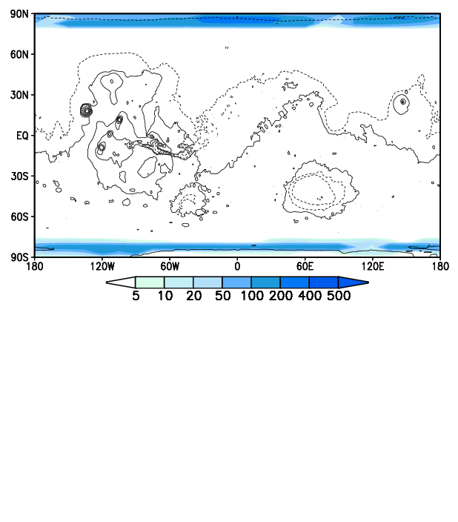
Smooth Mars experiment
7.5°
e = 0
t = 100 yrs

Slide 12
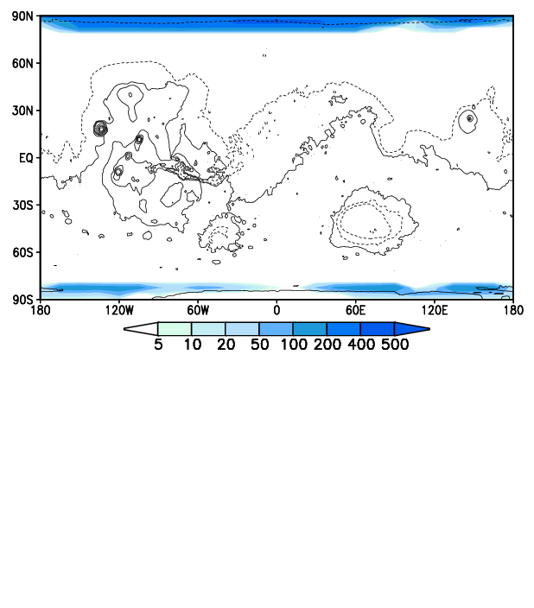
Smooth Mars experiment
7.5°
e = 0
t = 300 yrs

Slide 13
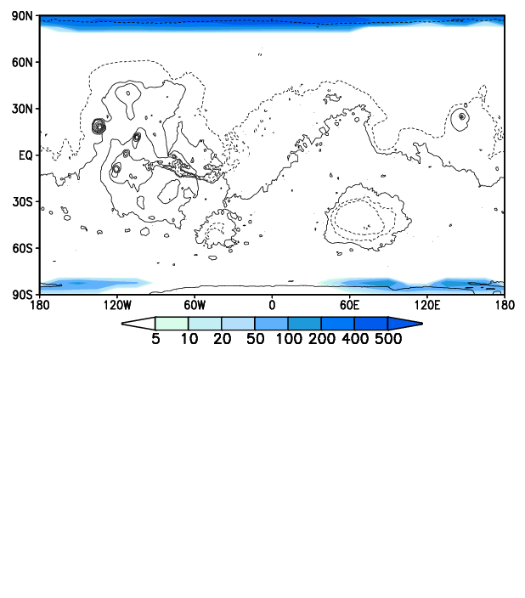
Smooth Mars experiment
7.5°
e = 0
t = 500 yrs

Slide 14
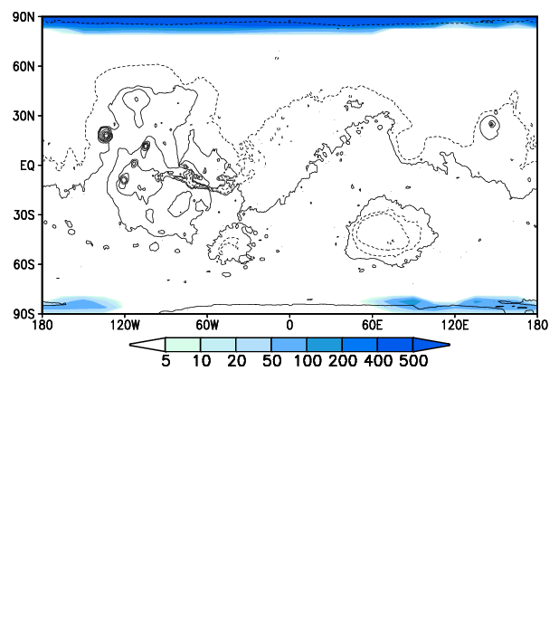
Smooth Mars experiment
7.5°
e = 0
t = 750 yrs

Slide 15
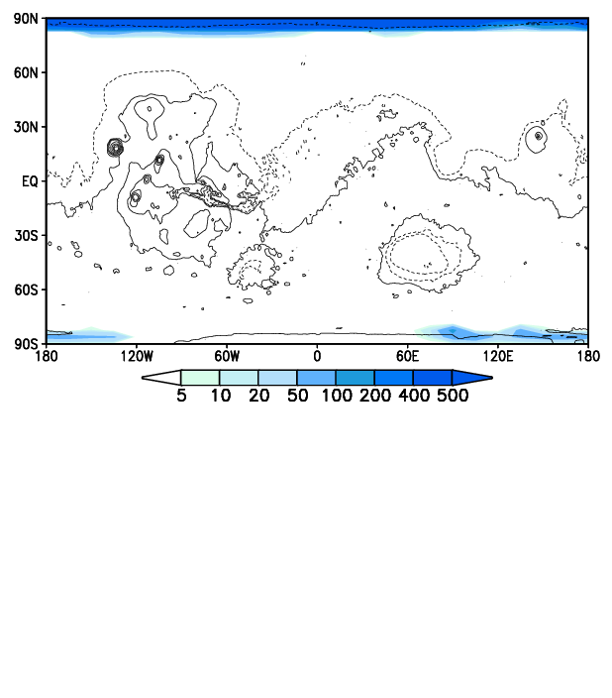
Smooth Mars experiment
7.5°
e = 0
t = 1000 yrs

Slide 16
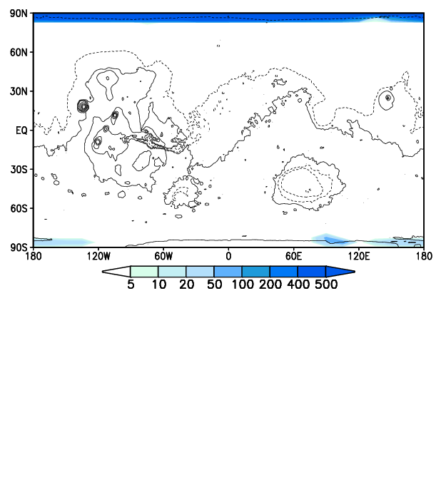
Smooth Mars experiment
7.5°
e = 0
t = 1250 yrs

Slide 17
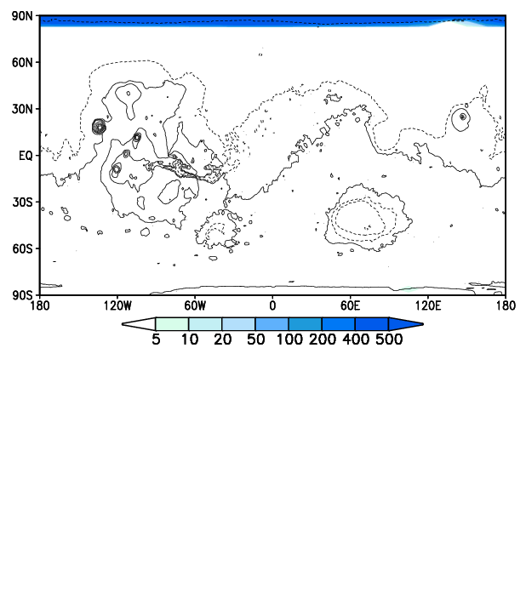
Smooth Mars experiment
7.5°
e = 0
t = 1500 yrs

Slide 18

Smooth Mars experiment
7.5°
e = 0
t = 2000 yrs

Slide 19
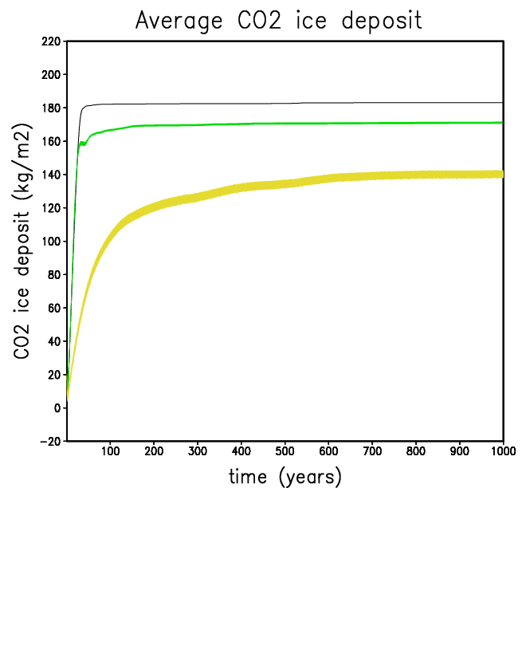
Smooth Mars experiment (1st 1000 years of a 5000 years runs)
ob = 0°
ob = 7,5°
ob = 15°
Notes:
The less the obliquity, the more the amount of co2 condensed
No annual variation at 0° : logical

Slide 20
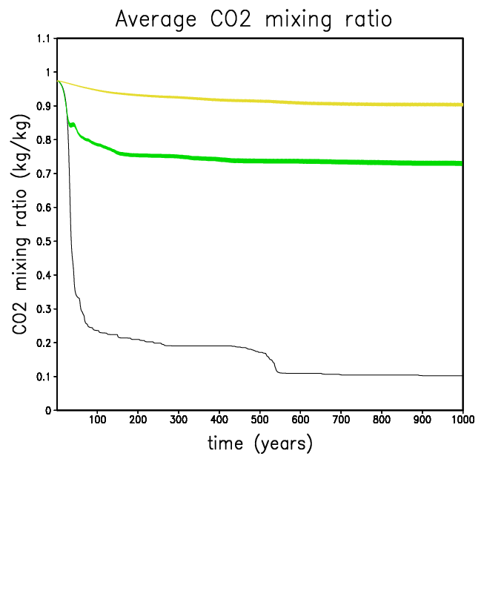
Smooth Mars experiment
ob = 15°
ob = 7,5°
ob = 0°

Slide 21
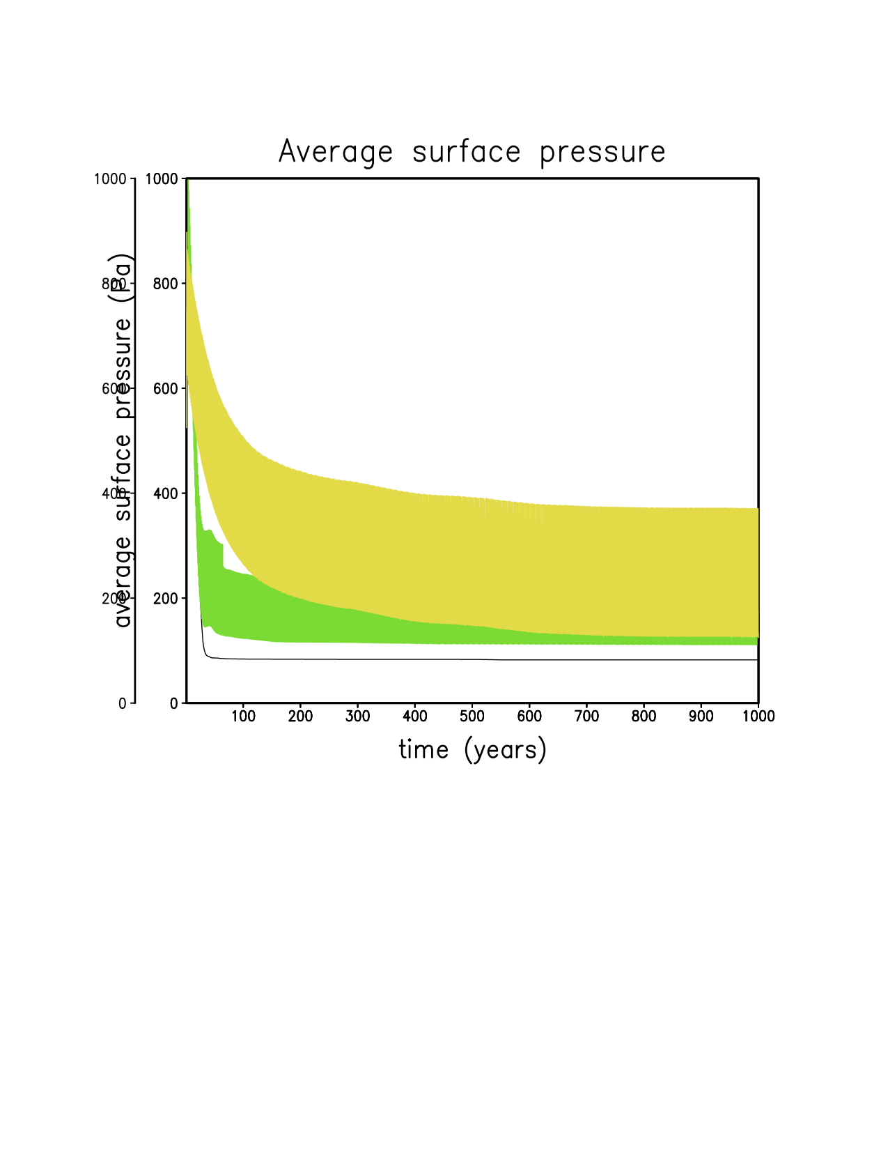
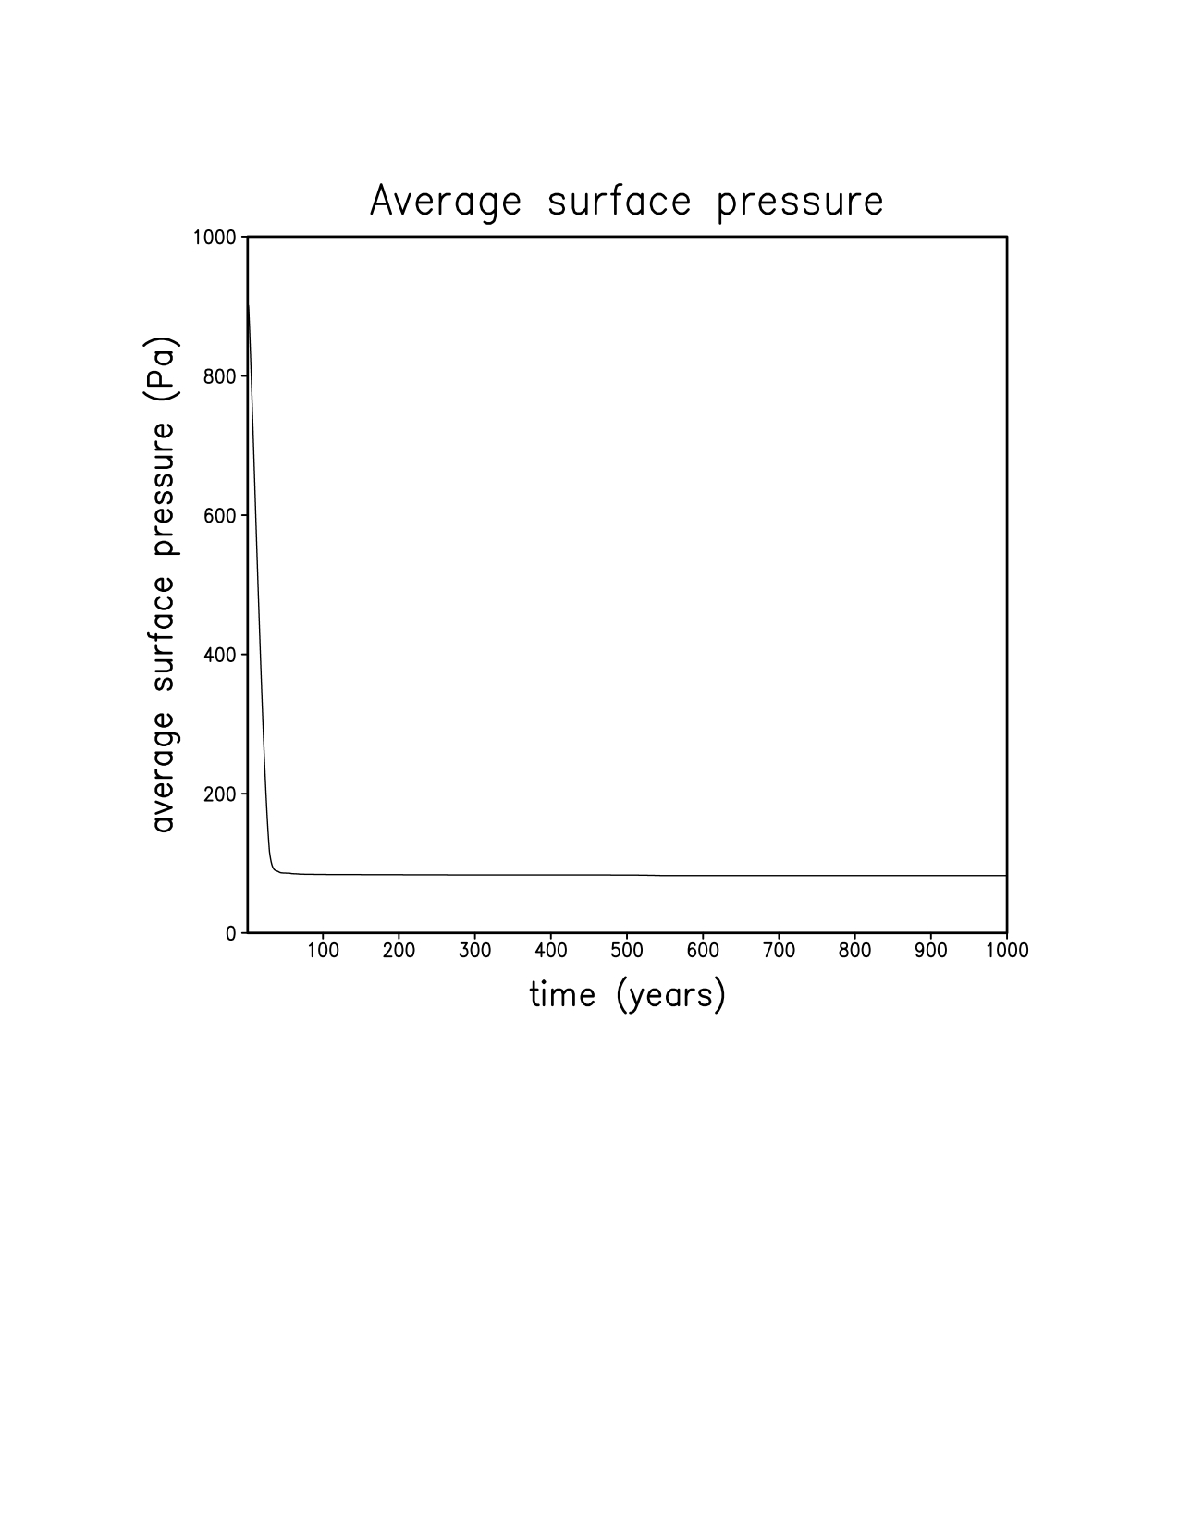
Smooth Mars experiment
ob = 15°
ob = 7,5°
ob = 15°
ob = 0°
ob = 7,5°
ob = 0°

Slide 22
Smooth Mars experiment
7.5°
e = 0
t = 3000 yrs

Slide 23
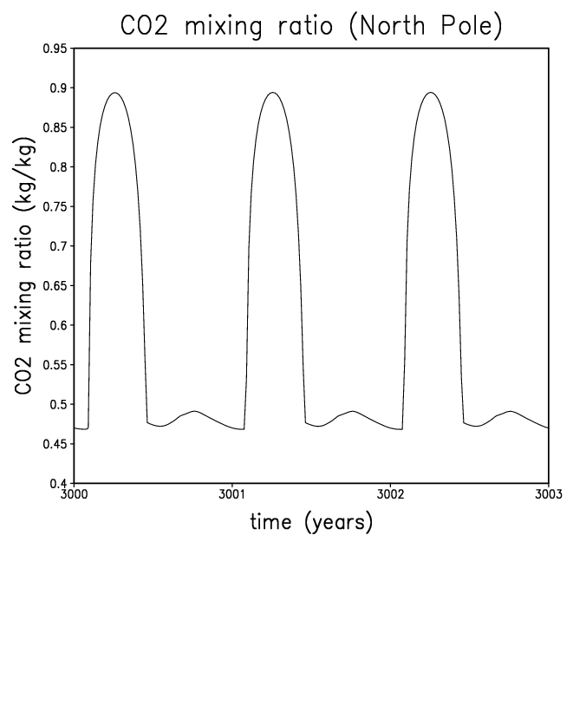
Smooth Mars experiment
Large gradient of composition and molar mass
Condensation / sublimation controlled by CO2 mixing ratio
Ar-N2 enrichment
CO2 depletion
Ar-N2 depletion
CO2 enrichment
pure CO2
CO2
Sublimation
Condensation

Slide 24
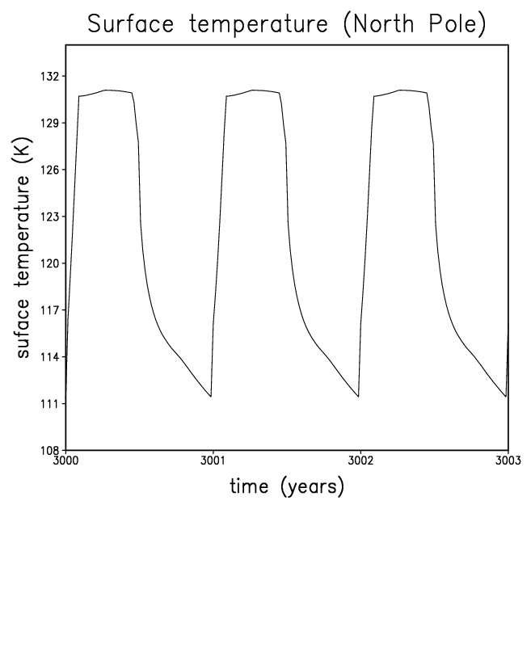
Smooth Mars experiment

Slide 25
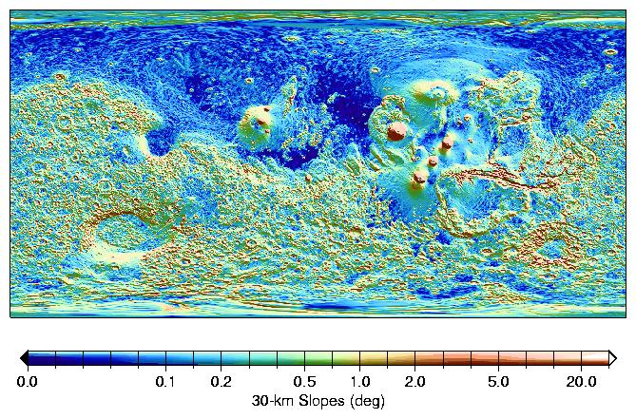
Rough Mars experiment
Mars is not flat!
Median slopes on 30-km baselines (from MOLA high resolution datasets)
(Smith et et al. 2001)

Slide 26
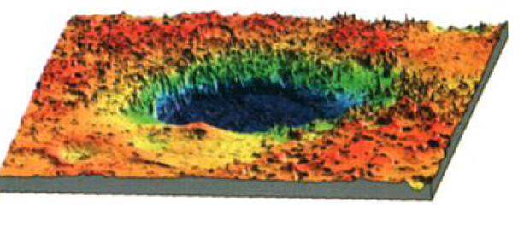
Rough Mars experiment
In each mesh : slopes are binned and represented by 7 representative slopes
CO₂ ice
1
7
2
6
3
4
5
Upgrades in the initial model:
Subgrid-scale slope distribution
Option : computing Ice flow

Slide 27
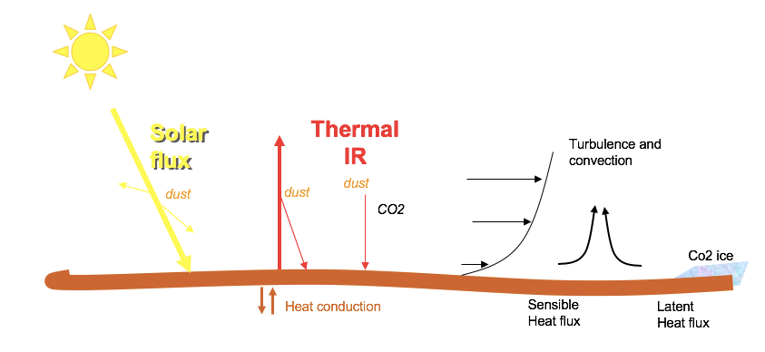
Rough Mars experiment
Calculation of the incident solar flux on any given slope
IR
IR

Slide 28
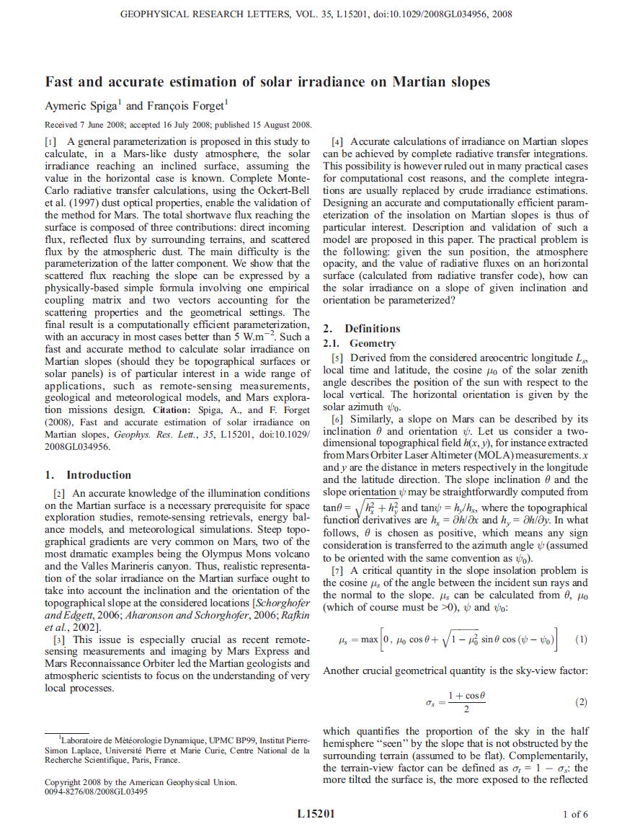
Rough Mars experiment
Insolation on slopes derived from Monte-Carlo simulations combined in a dedicated algorithm
(Spiga and Forget, GRL, 2008)

Slide 29
Rough Mars experiment
Calculation of the incident solar flux on any given slope :
Direct flux (non-scattered)
Flux scattered by dust
Flux reflected on “nearby” flat surface
Contribution of the thermal infrared fluxes from “nearby” flat surface (assuming same Temperature than on slope)
IR
IR

Slide 30
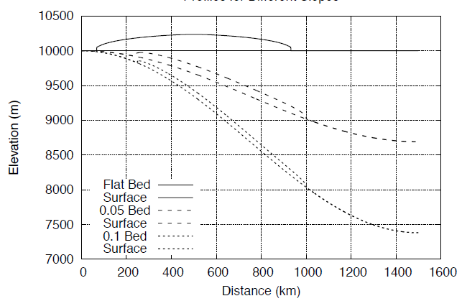
On slopes CO2 glaciers flows and remains thin
CO2 ice glacier profiles modeled by Fastook and Head (LPSC 2018)
We limit CO2 glacier thickness to 10 m => Extra ice moved to nearby less incline slope

Slide 31
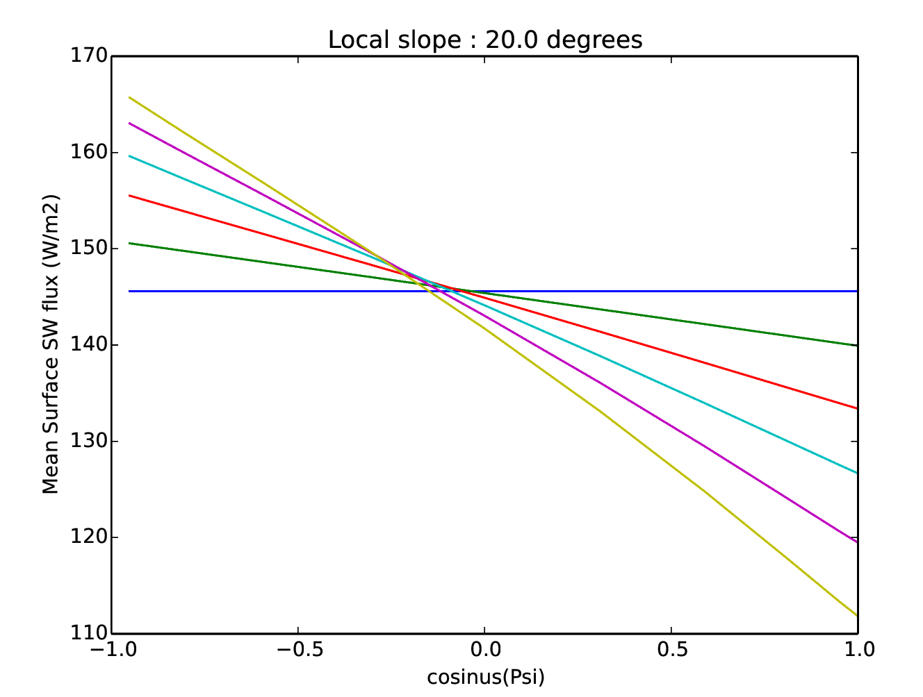
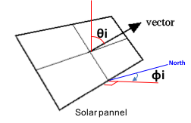
Rough Mars experiment
Inclination : 𝚹
Orientation : ɸ
0°
4°
8°
12°
16°
𝚹 cos(ɸ) seems to be a good criterium to compare insolation on slopes
20°
Mean solar insolation in function of the projection of the orientation on the South-North axis, for different slope inclinations (LMD1D)
Latitude : 30°N
LS(t=0) = 0°

Slide 32
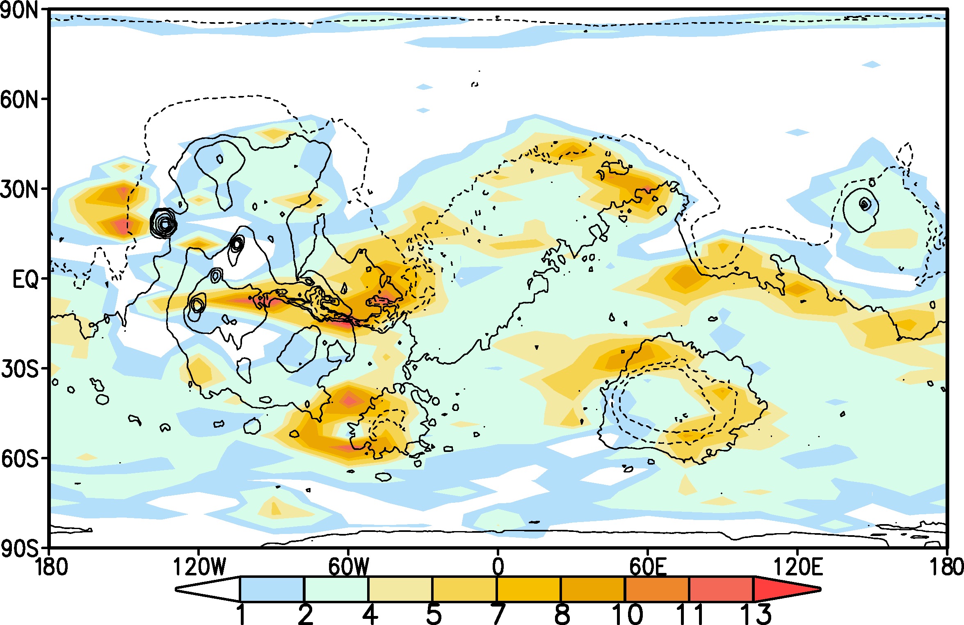
Rough Mars experiment
Distribution of slopes (percent) for 3° < 𝚹 cos(ɸ) < 9°

Slide 33
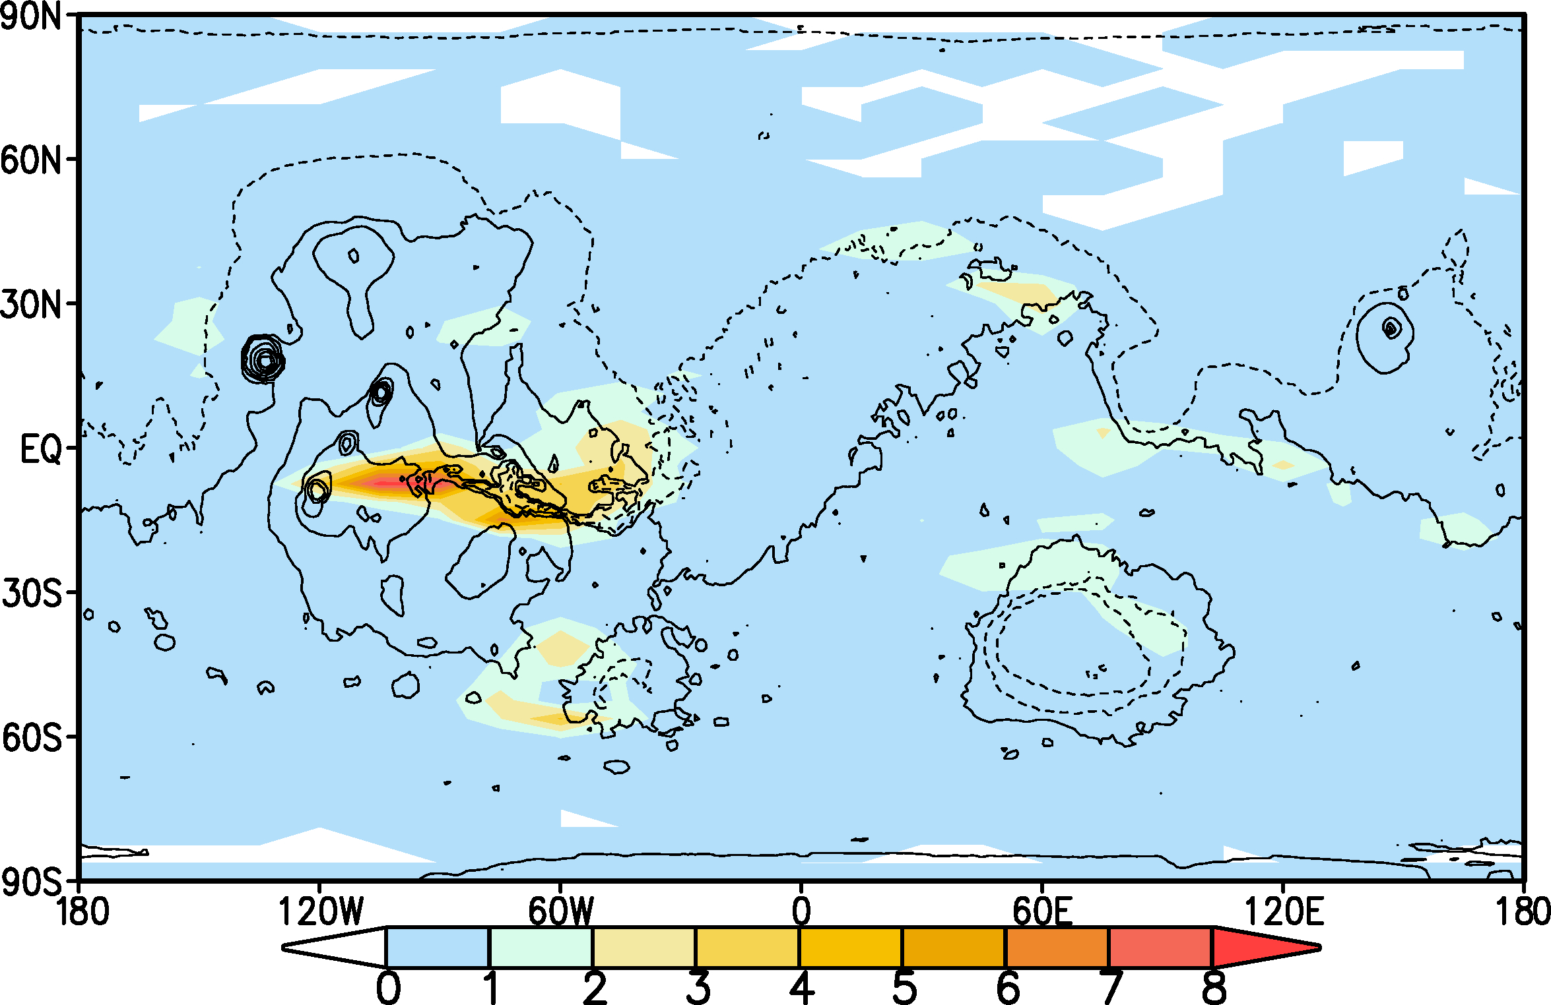
Rough Mars experiment
Distribution of slopes (percent) for 9° < 𝚹 cos(ɸ) < 20°

Slide 34
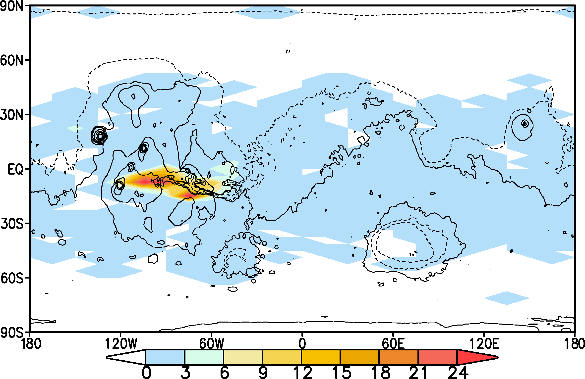
Rough Mars experiment
Distribution of slopes (perthousand) for 20° < 𝚹 cos(ɸ) < 43°

Slide 35
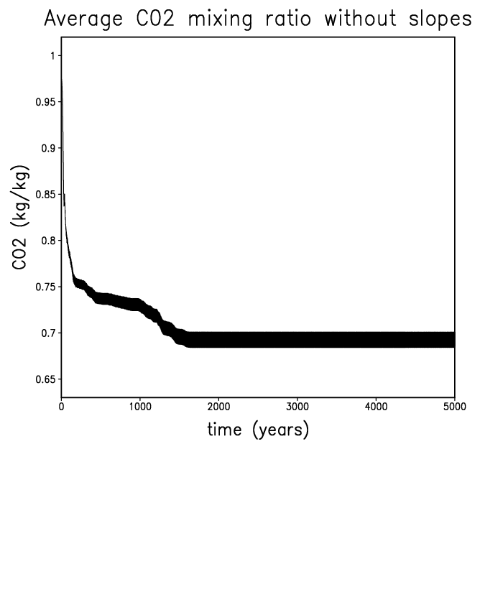
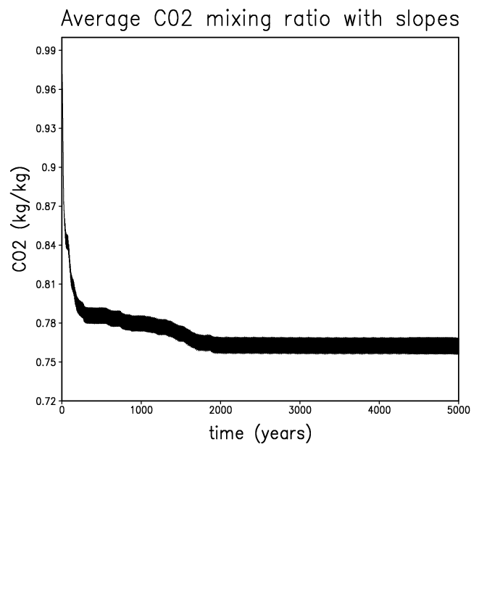
Smooth and rough models comparison
7.5°
More CO2 condensed without slopes
e = 0

Slide 36
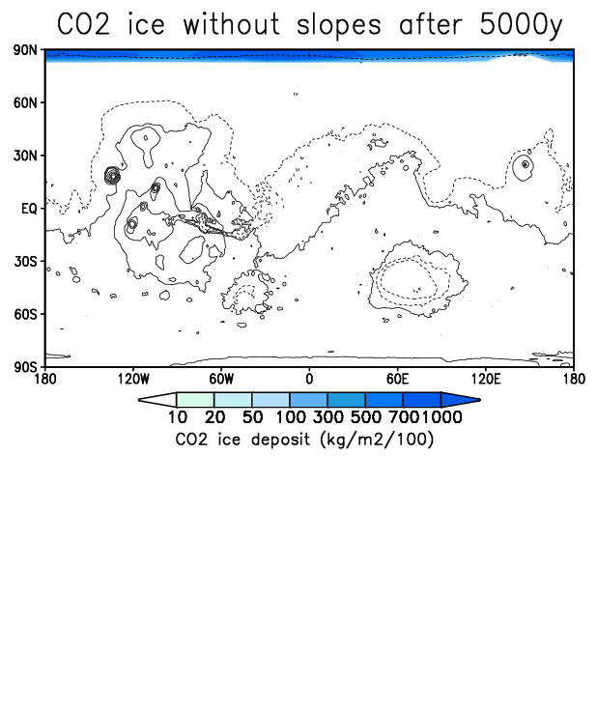
Smooth and rough models comparison
7.5°
e = 0

Slide 37
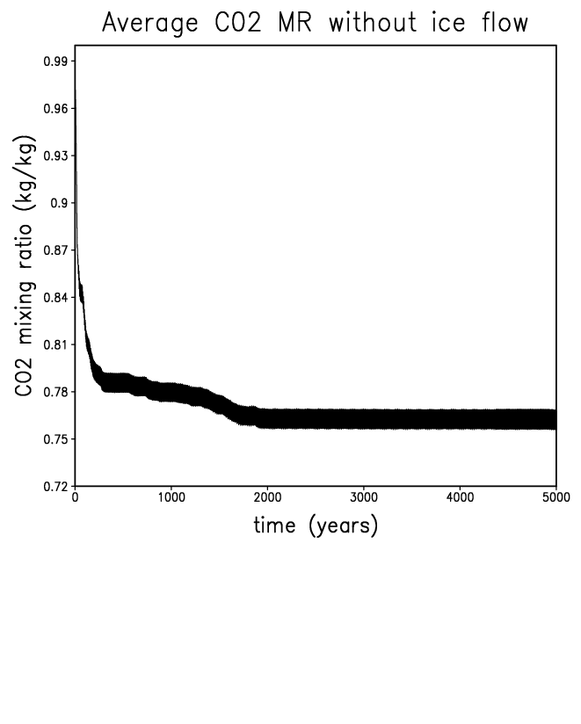
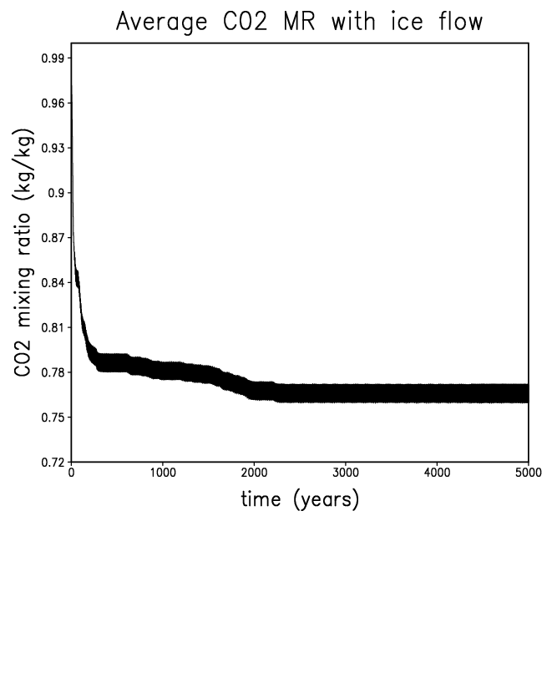
Rough Mars experiment
Ice flow option on ’rough’ model
7.5°
More CO2 condensed without ice flow
e = 0

Slide 38
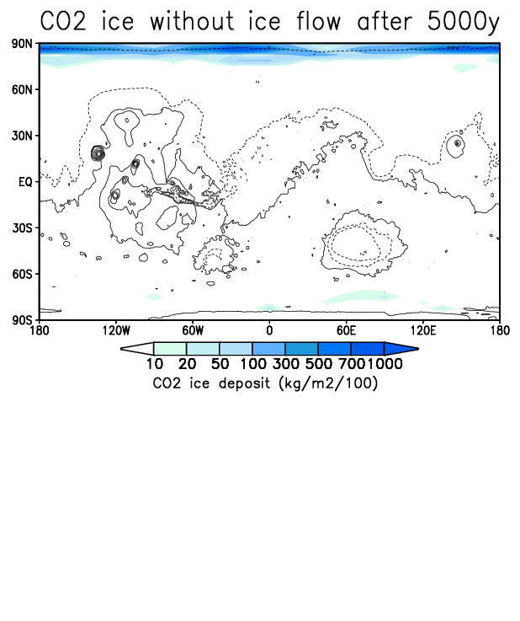
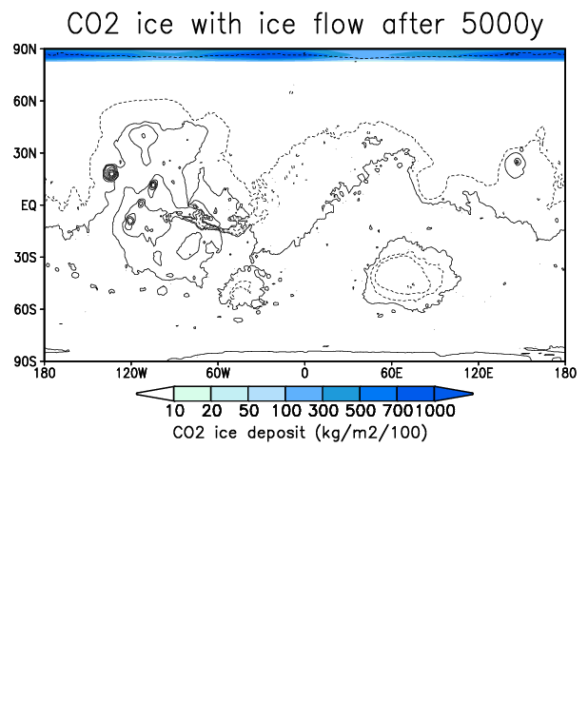
Rough Mars experiment
Ice flow option on ’rough’ model
7.5°
e = 0

Slide 39
Rough Mars experiment
Migration of CO2 from poles to high latitude pole facing slopes
15°
e = 0
t = 5000 yr

Slide 40
Modèle initial sans contribution des pentes
Calcul insolation / émissivité
Insol.
Calcul température de surface
Calcul Condensation / Sublimation CO2
T. surf.
Glace CO2
Emiss.
Nouveau modèle avec contribution des pentes
Insol.
Calcul température de surface
Calcul Condensation / Sublimation CO2
Pente 1
T. surf.
Glace CO2
Emiss.
x proportion pente 1
Calcul insolation / émissivité
Glace CO2 tot.
x proportion pente 7
Insol.
Calcul température de surface
Calcul Condensation / Sublimation CO2
Pente 7
T. surf.
Glace CO2
Emiss.

Slide 41
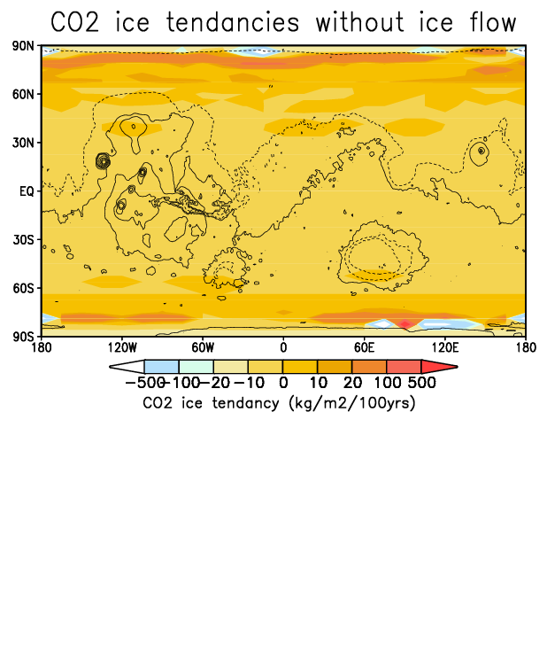
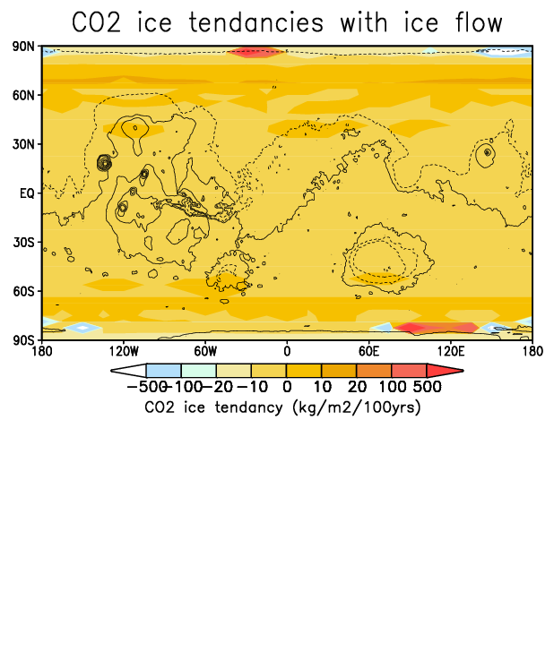
Rough Mars experiment
Ice flow option on ’rough’ model
15°
e = 0
t = 5000 yr

Slide 42
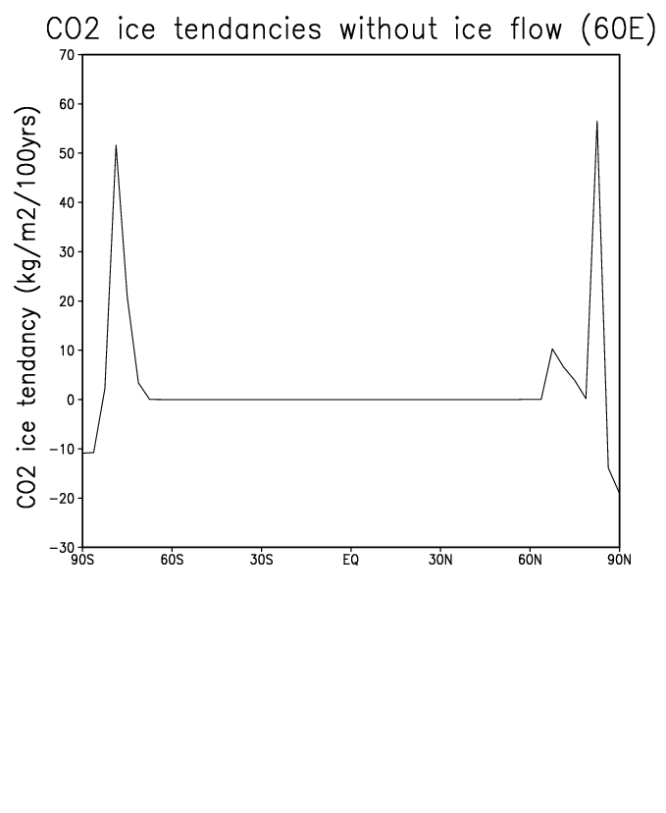
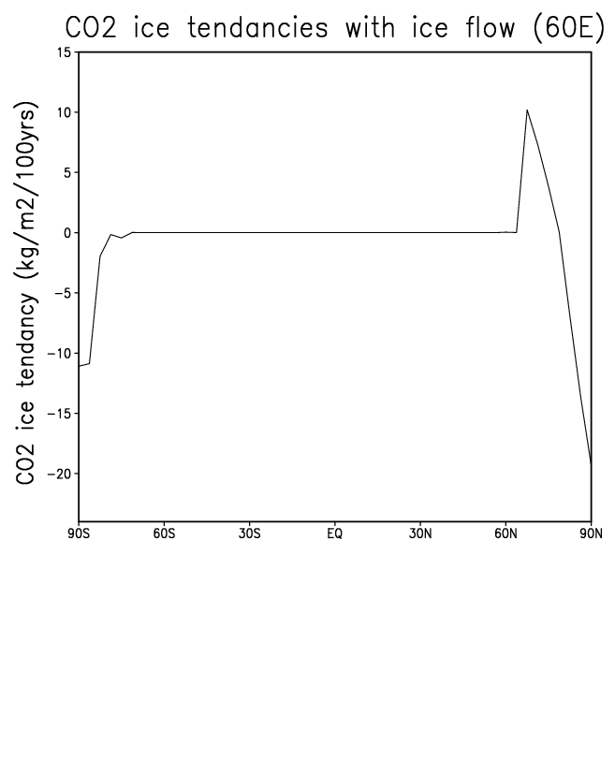
Rough Mars experiment
Ice flow option on ’rough’ model
15°
e = 0
t = 5000 yr

Slide 43
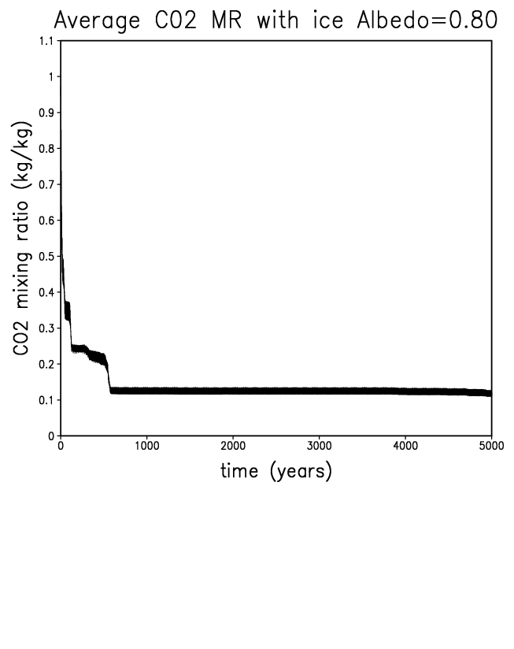
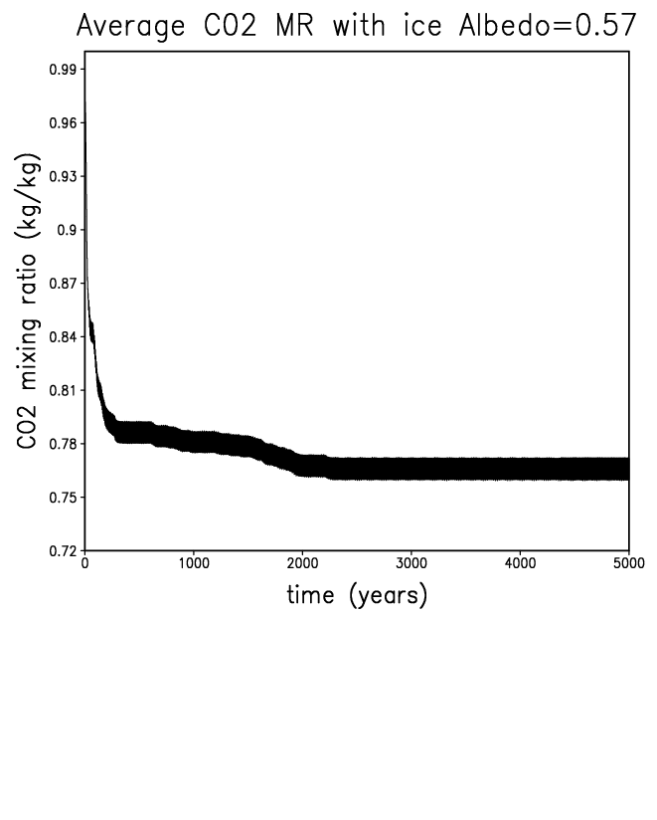
Impact of CO2 ice albedo
Rough Mars experiment
7.5°
Much more CO2 condensed with this value !
e = 0

Slide 44
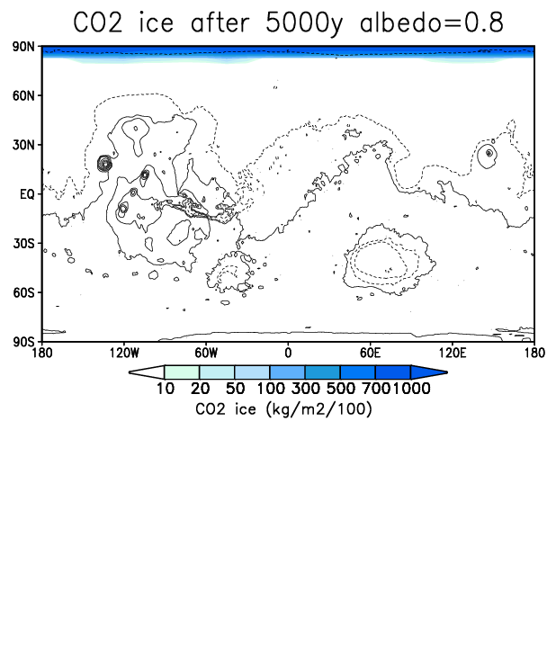
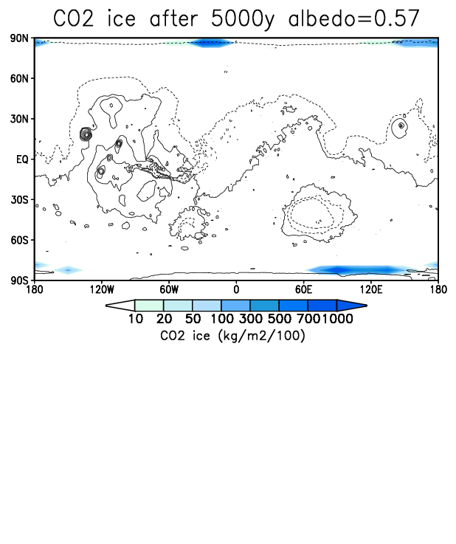
Impact of CO2 ice albedo
Rough Mars experiment
7.5°
e = 0

Slide 45
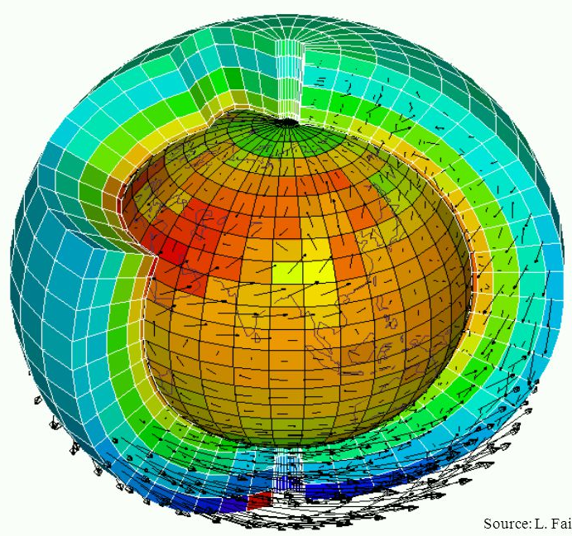

Slide 46
Preliminary Conclusions
Atmospheric collapse in only one reservoir in equilibrum with the atmosphere (cap or glaciers on poleward slopes)
If the modeled ice can flow : Slope glaciers can coexist with polar cap
Large variations of atmospheric composition (CO2 vs N2-Ar)
The CO2 ice surface temperatures stongly varies between condensation and sublimation phase
This induce horizontal gradient of molecular mass: exotic atmospheric dynamic !
Extreme sensitivity to the assumed CO2 ice albedo
To be continued !
UPCOMING : using these initial states to run a full GCM (with dynamics, AR-N2 transport AND the subgrid slope model etc…)
New goal : accurate simulation of yearly CO2 transport

